Slide 1
Index Term Selection
Review
  Simple techniques had been discussed:
    Based on automatically or manually thesaurus
    Stop word removal
Index term selection: select important terms for indexing

Slide 2
Importance of a Term
Importance of a term had been discussed in vector-space model, e.g., based on tfxidf.
  tf indicates a term’s local importance
  DF (or idf) indicates a term’s global importance
  both are from the query’s perspective
Term selection based on term discrimination value – importance of a term is measured by its ability in separating relevant documents from non-relevant documents
If term frequency is so important in term weighting, we should know more about occurrence frequencies of words in English.

Slide 3
Zipf’s Law (1949)
Principle of Least Effort:
  People act so as to minimize their probable average rate of work (i.e., over a long period of time and a large population)
  Many statistical distributions in human language follow Zipf’s law
Given a large corpus of common English writings
Order the list of words in decreasing order of their occurrence frequencies f in the corpus
Zipf’s law relates f of a word and its rank r in the list:
  f ∝ 1/r or f * r ≈ constant
Other observations:
  most frequent words tend to be short (principle of least effort)
  most frequent 20% of words account for 60% of usage
You can see the advantage of stopword removal; many words with high total number of occurrences are removed, which are not useful for retrieval anyway (see term discrimination)

Slide 4
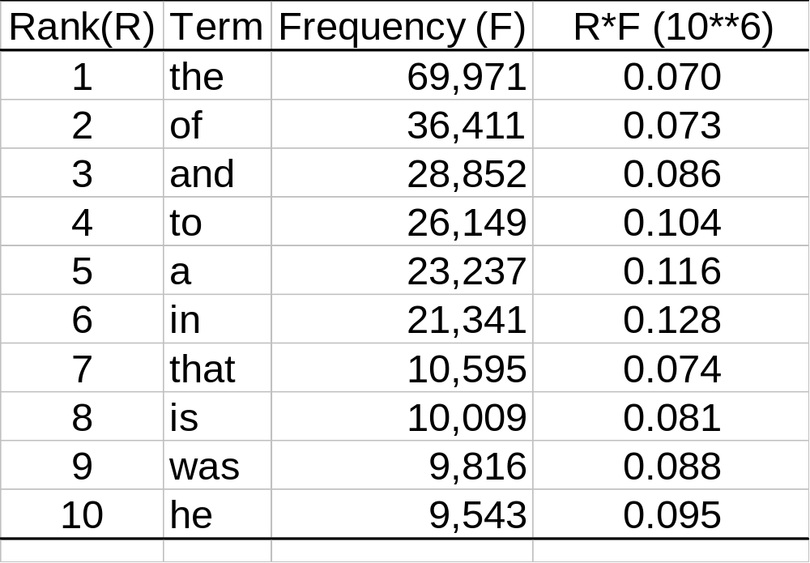
Zipf’s Law -- An Example

Slide 5
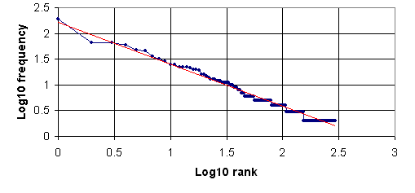
Plotting the Zipf’s Law
y = -0.81x + 2.21
Zipf’s law would predict the slope to be -1
Mandelbrot’s formula (1954)
  log f = log P – B log(r +ρ) where P, B and ρ are constants

Slide 6
Zipf’s Other Observations
The number of meanings (m) of a word is correlated with its frequency
  m ∝ √ f
Content words tend to clump together
  Content words are words which occur at most 24 times in the corpus
  Find the number of times F that two content words appear in interval size I (I = 1, 2, 3, etc.)
  F ∝ I^{-p} where p varies between 1 and 1.3

Slide 7
Power Law
A power law exhibits scale invariance, i.e., “scale free”
  y = a⋅x^{k} + o(x^{k}) a, k are constants, o() is a small function of x
  log y = k log x + log a
  k: scaling exponent
“Scale free” means that as x increases (i.e., scales up, e.g., by 10 times or 100 times), the behavior of y remains to be predictable (that logy and logx are proportional)
Zipf’s law is a power law
Power law fits many natural phenomenon, including the internet and web; can you give a few examples?

Slide 8
Power Law in IR?
Power law is a generalization of Zipf’s law
Zipf’s law applied to word distribution in documents
Not sure how to exploit word distribution in IR other than weighting a term with frequency …
Scale free behavior is observed is:
  A new node can be attached to any existing node
  Attachment prefers nodes that are already well connected
Growth of Internet/Web
  Connectivity is fault tolerant again random node failure
  But highly affected by failure of highly connected nodes
Growth of protein structure

Slide 9
Simple Indexing Scheme Based on Zipf’s Law
Use term frequency information only:
Compute frequency of term k in document i, Freq_{ik}
Determine total collection frequency
TotalFreq_{k} = ∑ Freq_{ik} for i = 1, 2, …, n
Arrange terms in order of collection frequency
Set thresholds - eliminate high and low frequency terms
Use remaining terms as index terms

Slide 10
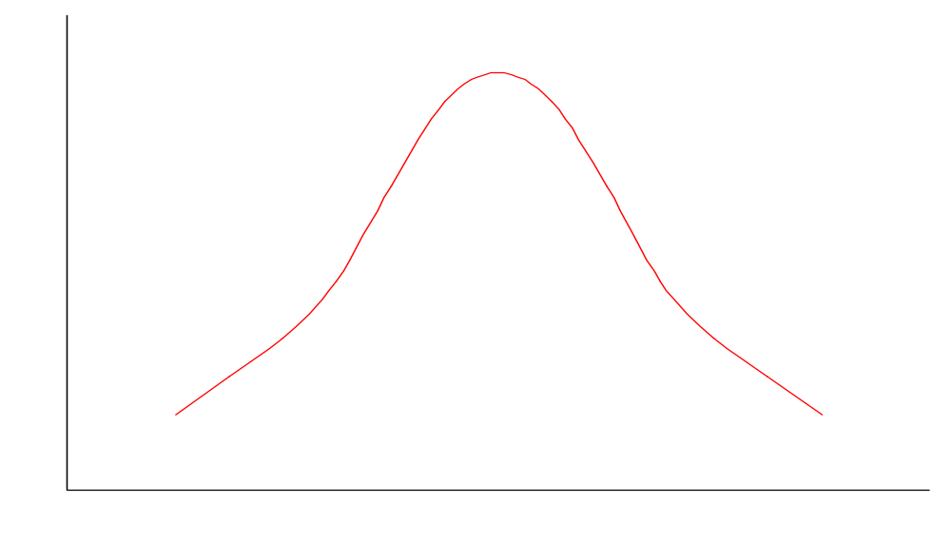
Resolving Power of Word
Non-significant
high-frequency
terms
Non-significant
low-frequency
terms
Presumed resolving power
of significant words
Words in decreasing frequency order

Slide 11
Critiques of the Simple Scheme
Effect of eliminating high and low frequency terms:
  Eliminating high frequency terms ==> lost in recall
  Eliminating low frequency terms ==> lost in precision
A good index term should distinguish the documents to which it is assigned from the other documents (that don’t contain the term)
  Consider the term “the”
  Compare it with “database” and “Oracle”

Slide 12
Discussion on Corpus Analysis
Zipf’s law applies to many natural phenomenon
Another way of phrasing Zipf’s law is “the rich gets richer”
Language analysis: Effect of the Principle of Least Effort
  frequently used words are short and hence easy to remember
  more people using a word makes more people aware of it and hence using it
Distribution of wealth
Size of a community (or population of a city)
A web page’s number of inlinks
Outside linguistics, the law is generally called Power Law

Slide 13
Term Selection based on tf and idf
Based on tf
  Eliminate high frequency words by means of a stop list
  Compute the term frequency tf_{ij} for all remaining terms T_{j}
  Choose as index term with tf_{ij} exceeds the threshold
Based on idf
  Terms that occur rarely in a document collection enhances precision
  A possible measure is the inverse document frequency, idf
The use of combined term frequency and inverse document frequency provides better precision
w_{ij} = tf_{ij} · log(N/df_{j})

Slide 14
Discrimination Value of Indexing Terms
The purpose of an index term is to distinguish a document from another
If documents are visualized as existing in a document space (of high dimensions), a good index term should spread out the document as much as possible. For example, given a computer science collection:
X
X
X
X
X
X
X
X
X
X
X
X
Given document space w/
index: system
Adding a good index term
index: system, database
Adding a poor index term
index: system, computer

Slide 15
Term Discrimination Value -- An Example
 | All Terms | Current index | Bad | Good
D1 | (a,b,c,d,r) | (b,c,d) | (a,b,c,d) | (b,c,d,r)
D2 | (a,b,n,d,r) | (b,n,d) | (a,b,n,d) | (b,n,d,r)
D3 | (a,m,p,q) | (m,p,q) | (a,m,p,q) | (m,p,q)
D4 | (a,x,p,q) | (x,p,q) | (a,x,p,q) | (x,p,q)
Including a will make similarity for every pair of documents greater than 0
Including r will bring d1 and d2 closer while separating them farther away from d3 and d4

Slide 16
Effect of a New Index Term on Similarity Values
Adding a term is like adding one more dimension to the vector space.
Documents not containing the term will not change.
Document containing the term will be dragged apart from those not containing the term.
T2
T2
T3
T1
T1

Slide 17
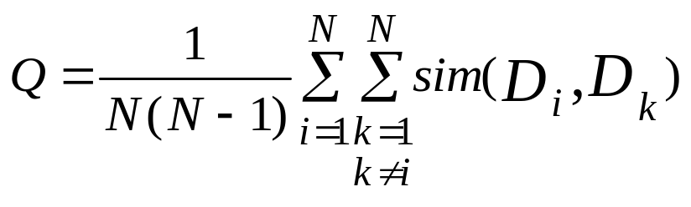
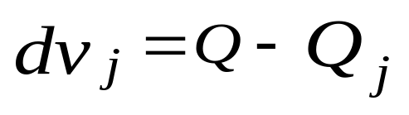
Definition of Term Discrimination Value
Suppose two documents are similar if the distance between them in the document space is short. Therefore, a good index term should decrease the overall similarity between the document pairs.
Average similarity value between document pairs in N documents
If Q and Q_{j} are the average similarity values before and after adding term j to the documents of a collection, term discrimination value is defined as
Good index terms have
positive dv values (i.e., Q_{j} has a smaller similarity than Q)

Slide 18
Term Discrimination Value and Document Frequency
Term discrimination value has an intricate relationship with document frequency
In general, small df yields positive dv
dv
When index term j is added, documents containing j will become closer together.
When the number of documents containing j is large, total similarity will increase, turning dv from positive to negative.
1
2
3
4
5
N
df

Slide 19
dv versus idf
dv
idf
1
2
N
df

Slide 20
Term Discrimination Value -- (3)
Discrimination value of term j, dv_{j} increases from zero to positive as the document frequency of the term increases, and then decreases as the document frequency becomes still larger.
Discrimination value provides an objective measure for determining the frequency thresholds
  high-frequency terms with negative dv are poor and should not be used directly for indexing purpose
  low frequency terms with zero dv may or may not be used
  good indexing terms are those having positive dv
Terms with low frequency but negative dv are those terms which can make the (few) documents containing them very very close together.

Slide 21
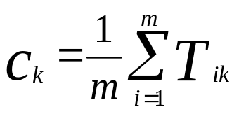
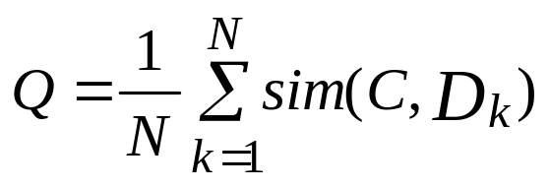
Document Centroid
Computation of dv_{j} is expensive
  Require computing the similarity between N(N-1)/2 document pairs for each term
  Require recomputation after document updates.
A compromise: Find the centroid C of the document space:
  C = (c₁, c₂, …, c_{j} …, c_{t})
  Compute Q as the similarity between each document and the centroid.

Slide 22
Term Weight Assignment
Recall that, in vector space model, a typical combined term importance indicator is
w_{ij} = tf_{ij}• idf_{j} = tf_{ij}• log₂ (N/ df _{j})
or, a normalized form
w_{ij} = (tf_{ij} /max{tf_{ij}}) • log₂ (N/ df _{j})
The weight of a term j in document i can also be expressed using the discrimination value of i instead of the inverse document frequency:
w_{ij} = tf_{ij} • dv_{j}

Slide 23
Pitfall of Term Discrimination Values
A term is a good index term if
  it can increase the dissimilarity among the documents
What if a term increase the dissimilarity of two supposedly similar documents?
Definition of term discrimination value doesn’t consider the distinction between relevant and non-relevant documents
Ideal case
documents containing j
index term j should only move relevant documents together
Relevant documents
Non-relevant documents

Slide 24
Probabilistic Term Weights
Probabilistic model makes explicit distinctions between occurrences of terms in relevant and non-relevant documents
If we know
p_{i}: probability of term x_{i} appears in relevant doc.
q_{i}: probability of term x_{i} appears in non-relevant doc.
p(university)= x/(x+y)
term=“university”
q(university)=v/(u+v)
Relevant documents containing “university” (x)
non-relevant
relevant
Relevant documents NOT containing “university” (y)
Non-relevant documents NOT containing “university” (u)
Non-relevant documents containing “university” (v)

Slide 25
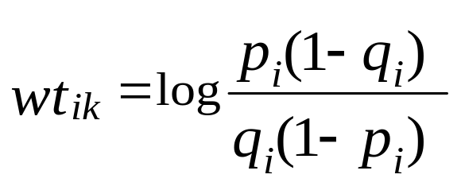
Probabilistic Term Weights
With binary and independence assumption, the weight of term x_{i} in document D_{k} is:
p_{i}=1, q_{i}=0 ⇒ wt_{i,k} → ∝
p_{i}=0, q_{i}=1 ⇒ wt_{i,k} → -∝
Estimates of p_{i} and q_{i} requires relevance information:
  using test queries and test collections to “train” the values of p_{i} and q_{i}
  any AI/learning technique?

